Slide 1

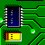
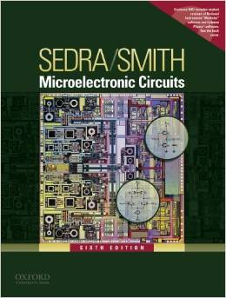


International University
School of Electrical Engineering
ANALOG ELECTRONICS
Lecture # 2: Building Blocks of Integrated Circuit Amplifiers
Text book:
Sedra and Smith, “Microelectronic Circuits,” 6th Edition.

Slide 2
Introduction
IN THIS CHAPTER WE WILL LEARN
The basic integrated-circuit (IC) design philosophy and how it differs from that for discrete-circuit design.
The basic gain cells of IC amplifiers, namely, the CS and CE amplifiers with current-source loads.
How to increase the gain realized in the basic gain cells by employing the principle of cascoding.
Analysis and design of the cascode amplifier and the cascode current source in both their MOS and bipolar forms.
How current sources are used to bias IC amplifiers and how the reference current generated in one location is replicated at various other locations on the IC chip by using current mirrors.
Some ingenious analog circuit design techniques that result in current mirrors with vastly improved characteristics.
How to pair transistors to realize amplifiers with characteristics superior to those obtained from a single-transistor stage.

Slide 3
Integrated Circuit Design Philosophy
Integrated-circuit fabrication technology More and more electronics circuits are integrated in a single chip
More complicated functions
Smaller size and lower cost
Suitable for mass-production
Large capacitors are not available
Very small capacitors are easy to fabricate
Implementation cost depends on device area rather than device count
Large/moderate-value resistors should be avoided
Larger/moderate-value capacitors should be avoided
Preferable to use transistors due to chip-area consideration
Design philosophy
The design philosophy for ICs is different from that of discrete-component circuits
Realize as many of functions as possible by using transistors only (MOS)
Rely on device matching or size ratios for circuit design
Active loads are typically used for amplifier designs
In this text, focus is placed on CMOS circuit fabrication.

Slide 4
The Basic Gain Cell
Two types of basic gain cells exist:
Common-source (CS)
Common-emitter (CE)
Both are loaded with constant-current source.
This is done because of difficulties associated with fabrication of exact resistances.
by using a constant-current source we are in effect operating the CS and CE amplifiers with a very high (ideally infinite) load resistance
It also facilitates increased gain.
These circuits are referred to as current-source loaded / active loaded.

Slide 5
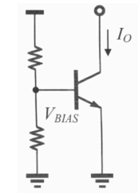
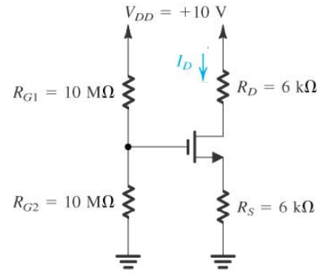
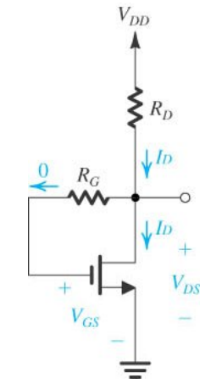
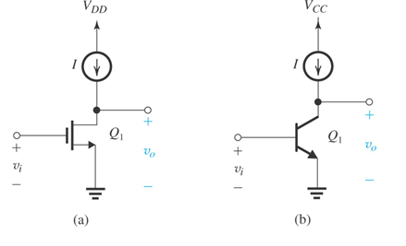
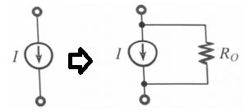
Circuits with discrete components
The constant current source is a basic element in circuit design. An ideal constant current source has an infinitely large internal resistance (Ro), as shown below on the left.
Current sources used to bias IC amplifiers

Slide 6
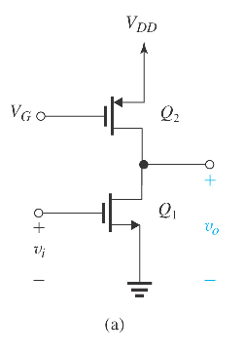
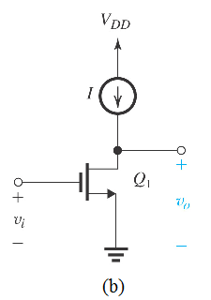
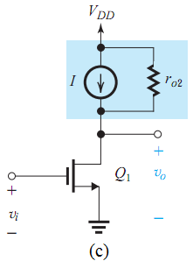
1. Method 1: The current source can be realized by using a PMOS in saturation
Q1 is biased using Q2
Ideal current source I
Practical current source I

Slide 7
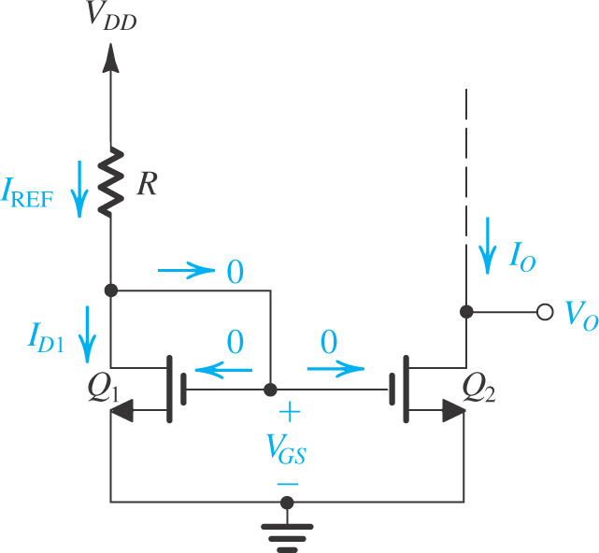
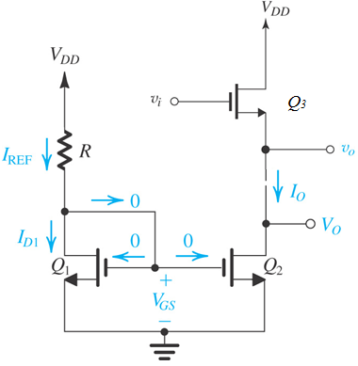
2. Method 2: Use Current-Mirror Circuits
Figure: Circuit for a basic MOSFET constant-current source. For proper operation, the output terminal, that is, the drain of Q₂, must be connected to a circuit that ensures that Q₂ operates in saturation.
Figure: Q3 is biased by current –mirror circuit.

Slide 8
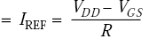
Current-Mirror Circuits
Figure shows the circuit of a simple MOS constant-current source.
The heart of the circuit is transistor Q₁, the drain of which is shorted to the gate, thereby forcing it to operate in saturation mode.
The drain current of Q₁ is supplied by V_{DD} through resistor R which in most cases is located outside of the IC chip.
If one considers transistor Q₂, it is realized that it has V_{GS} identical to Q₁
Consider transistor Q₂
=> If Q1 and Q2 are identical, then I₀=I_{REF}

Slide 9
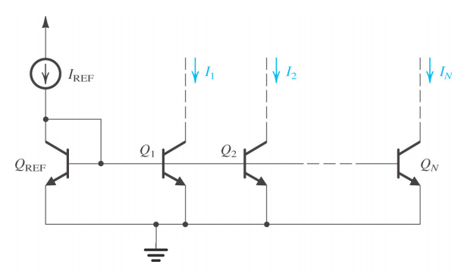
we can “mirror” currents at different levels by having multiple mirror circuits
The figure shows an N-output current mirror with BJT

Slide 10
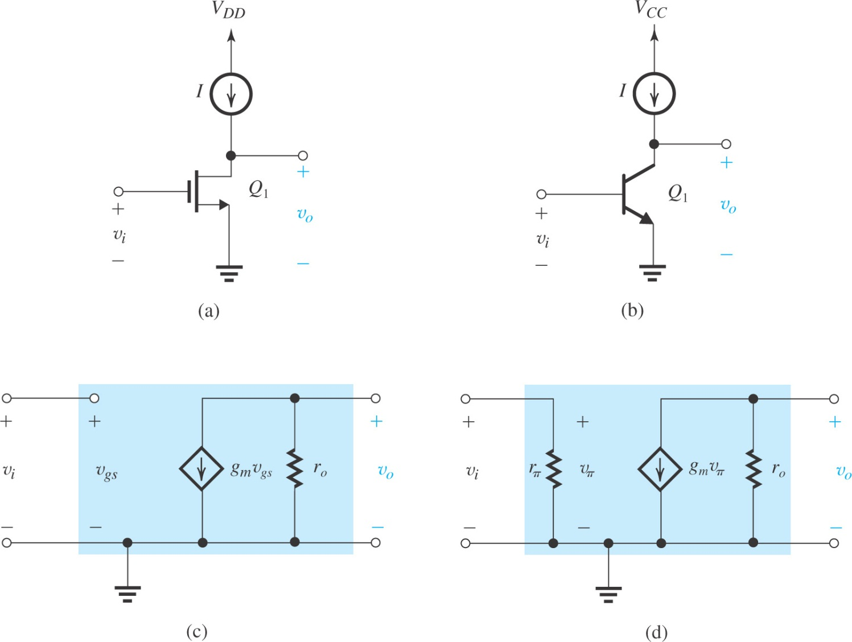
Figure: The basic gain cells of IC amplifiers: (a) current-source- or active-loaded common-source amplifier; (b) current-source- or active-loaded common-emitter amplifier; (c) small-signal equivalent circuit of (a); and (d) small-signal equivalent circuit of (b).

Slide 11
Quiz 2.1
The given circuit has the following parameters:
V_{DD} = 1.8V, (transistor Q2) V_{G} = 1V, μ_{p}C_{ox} = 90 μA/V²,V_{tp} = -0.5V , W/L = 22.3
What is the role of transistor Q2?
What is the circuit configuration of transistor Q1?
Compute current I_{D} of transistor Q2.
If the output resistance of transistor Q2 is 500 kΩ, determine the Early voltage of transistor Q2.
Determine g_{m} of transistor Q1 if V_{OV} = 0.3V.
You submit your solution not later than March 20, 2020.
You can submit through Blackboard as informed by Mr. Huy on Blackboard announcement.

